Slide 1
INFORMATION SECURITY
Huynh Nguyen Chinh, PhD

Slide 2
Contents
Chapter 1: Computer Security Concepts
Chapter 2: Software & OS Security
Chapter 3: Authentication & Access Control
Chapter 4: Database Security
Chapter 5: Malicious Code
Chapter 6: Firewalls & Intrusion Detection
Chapter 7: Introduction to Cryptography
Chapter 8: Symmetric Encryption
Chapter 9: Public Key Encryption

Slide 3
References
William Stallings and Lawrie Brown (2014), Computer Security, Principles and Practice, Third Edition
Wenliang Du (2017), Computer security a hands-on approach (https://seedsecuritylabs.org/)
Mark Stamp (2011), Information Security, Principle and Practices, 2nd Edition, Wiley Inc. Publication
W. Stallings (2011), Cryptography and Network Security - Principles and Practices. 5th edition, Pearson.
Matt Bishop (2004), Introduction to Computer Security, Prentice Hall

Slide 4
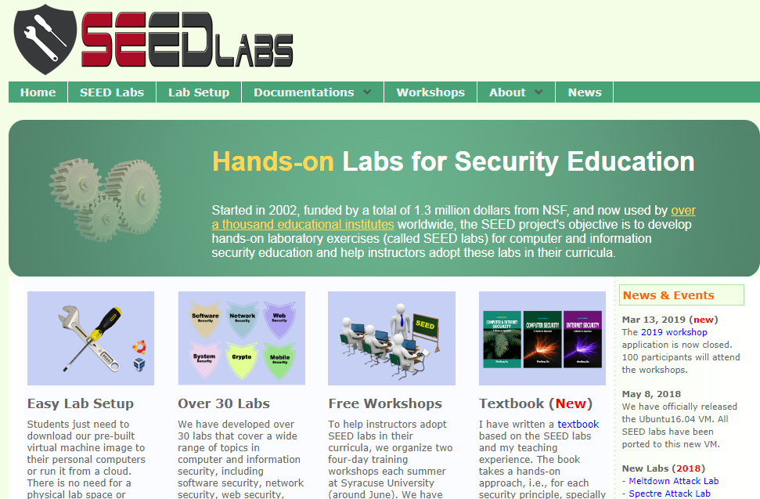
Labs

Slide 5
Tests
Midterm: 50%
Participation in class activities
MCQs (online or offline)
Labs:
Lab-1. Buffer overflow
Lab-2. Authentication & access Control
Lab-3. Database security (SQL injection)
Lab-4. Malware
Lab-5. FW & Intrusion detection
Final test: 50%
MCQs (online) or topics

Slide 6
Q&A

